Slide 1
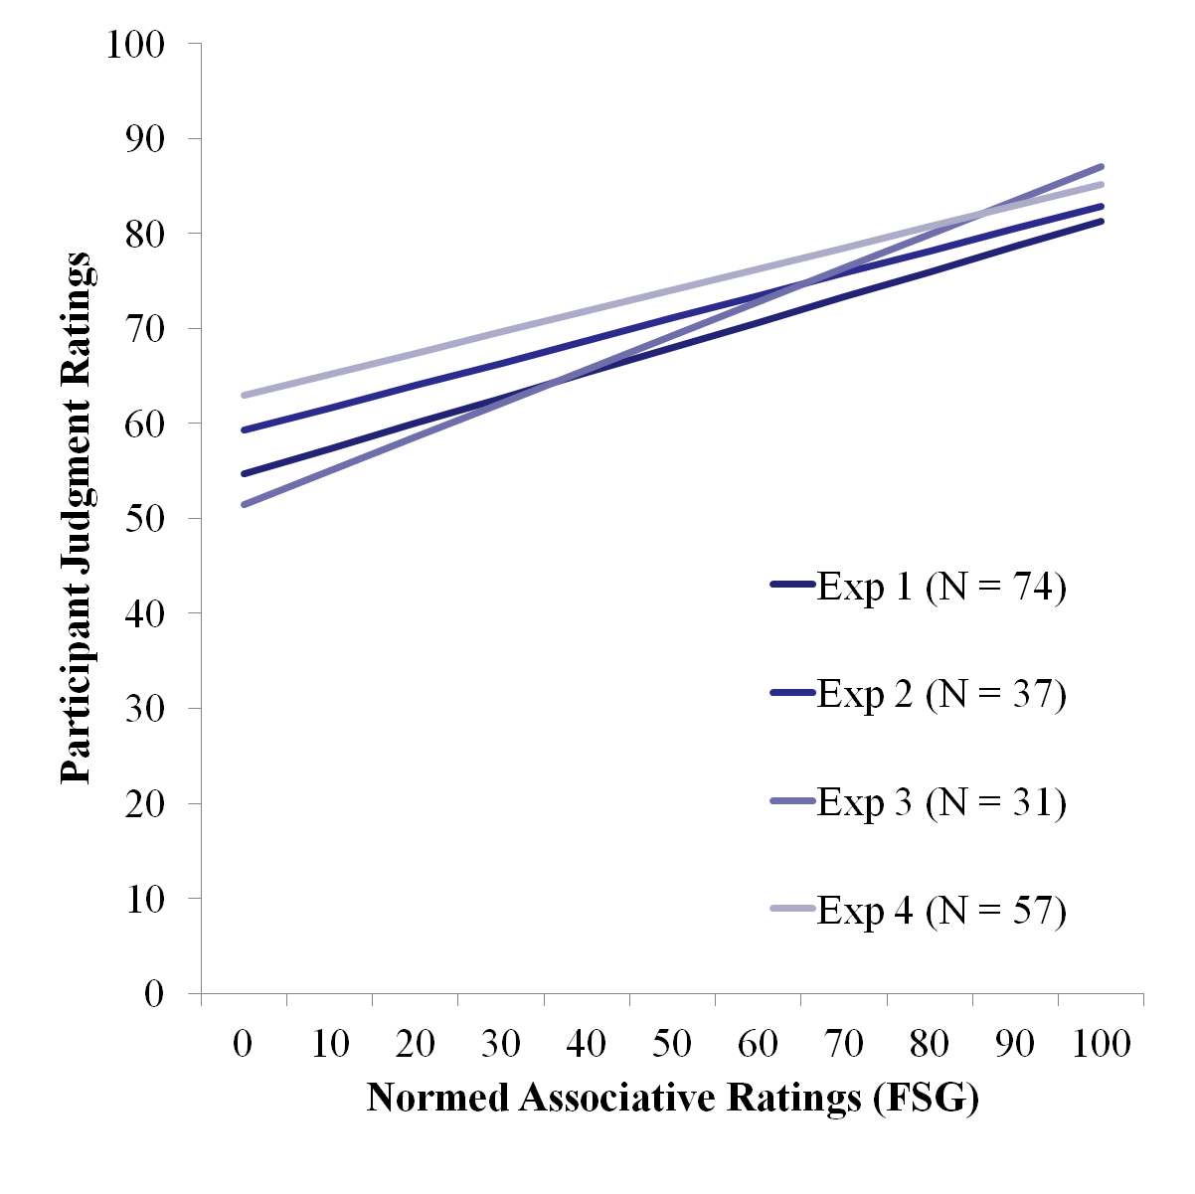
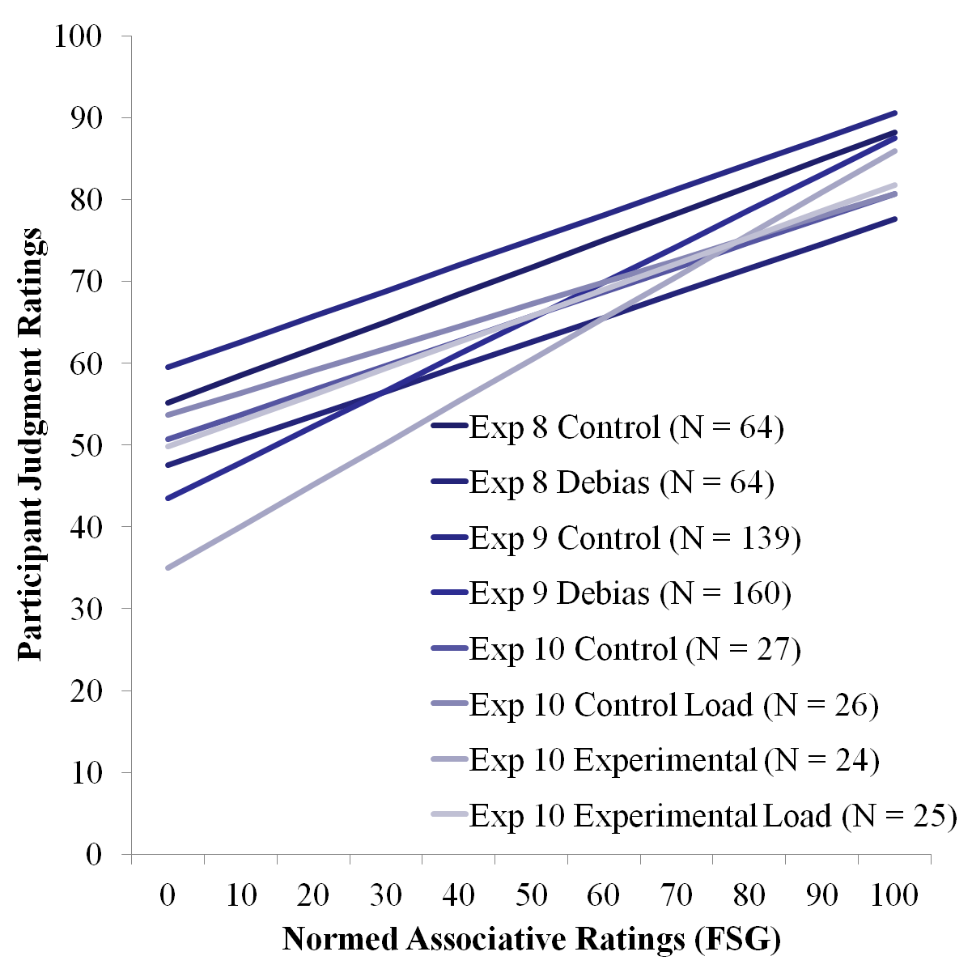
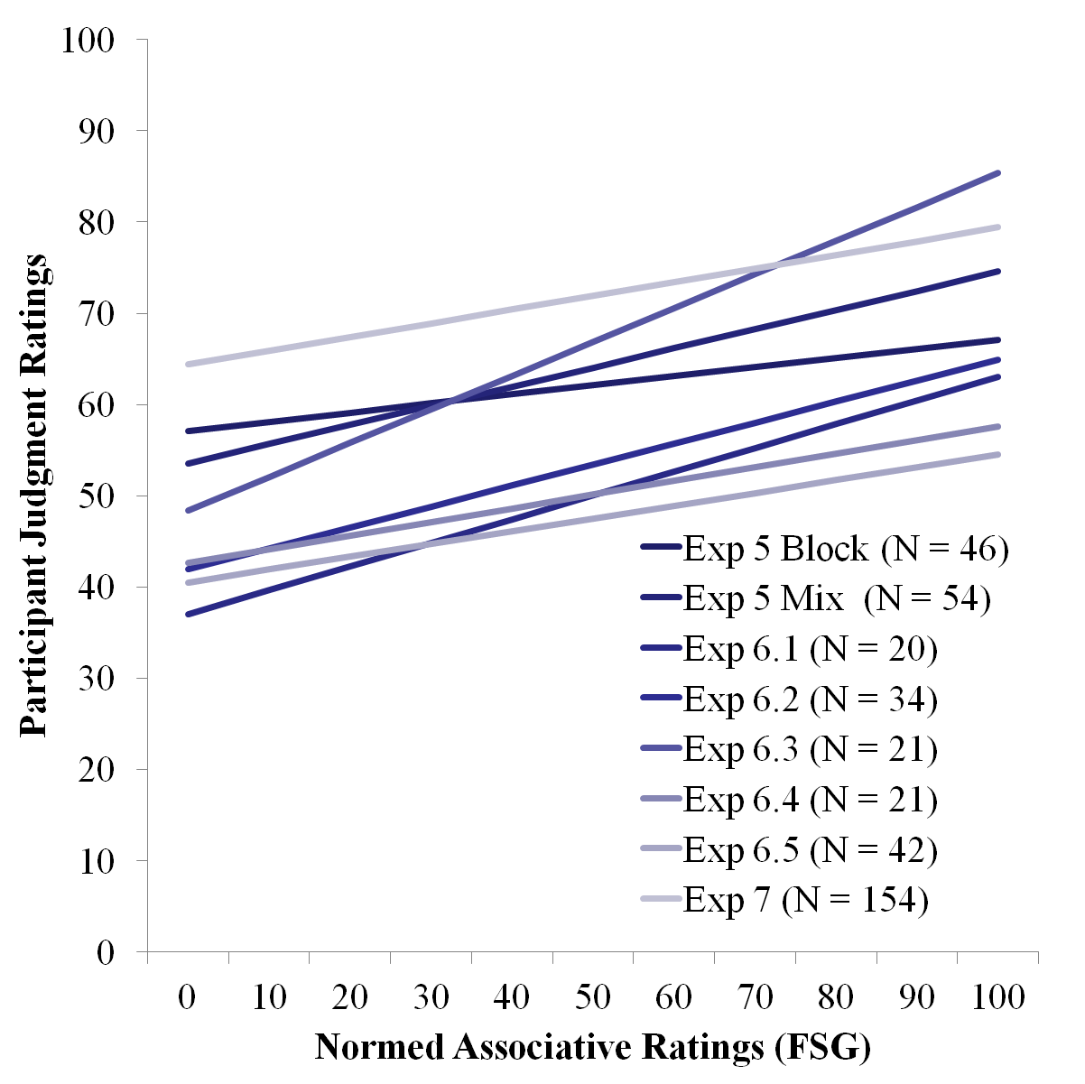
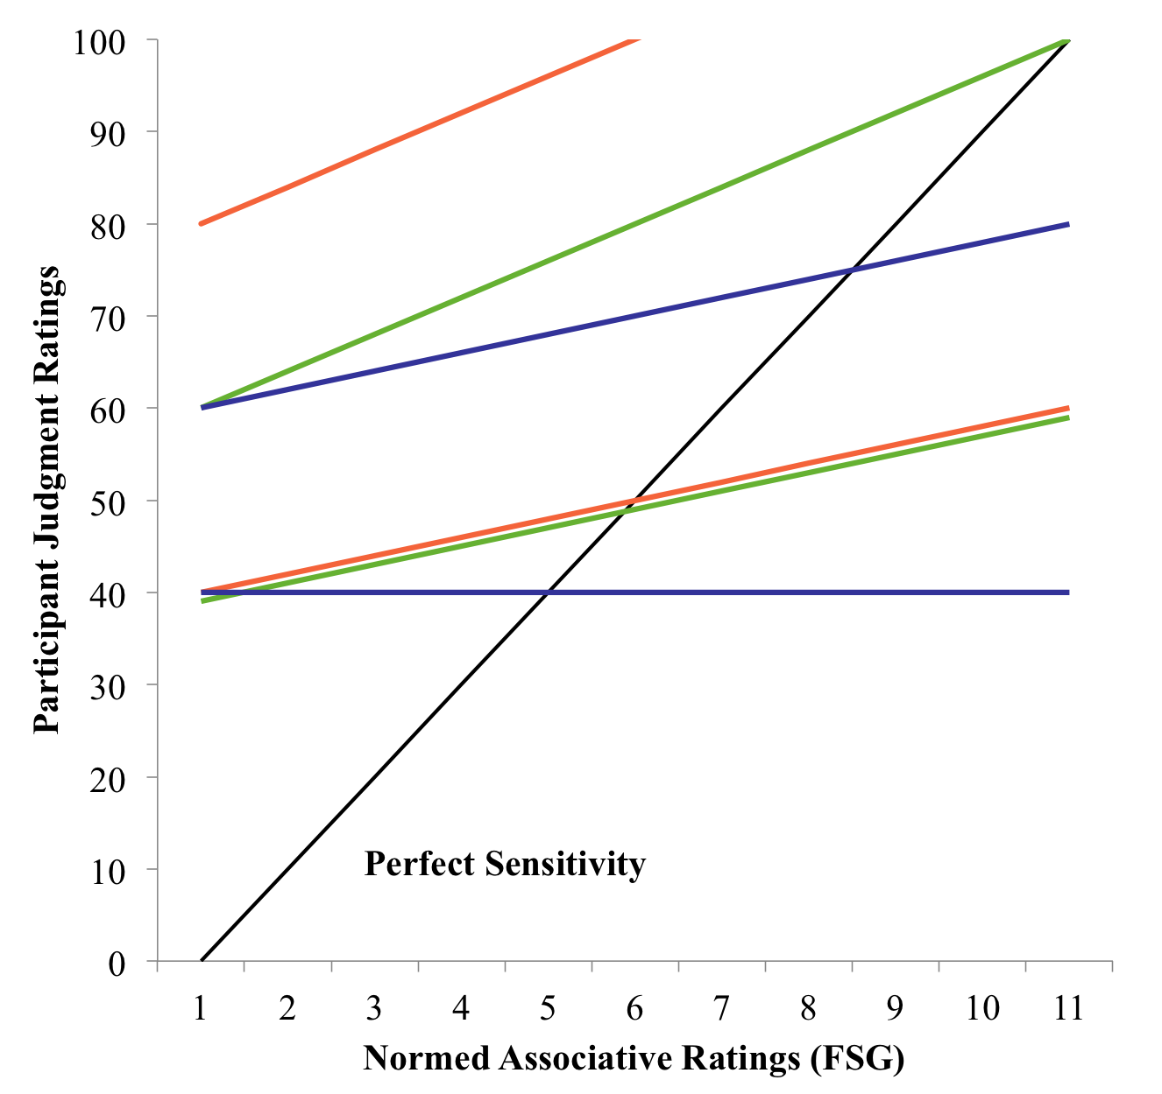
JAM-boree: A Meta-Analysis of Judgments of Associative Memory
Kathrene D. Valentine, Erin M. Buchanan, Missouri State University
Abstract
Judgments of associative memory (JAM) have been analyzed as a gateway to understanding the underlying cognitive architecture to context-based memory. Typically, participants are asked to rate the frequency of word-pairings, such as LOST-FOUND, in a JAM task. These ratings are then compared to actual normed associative frequencies (Nelson, McEvoy, & Schreiber, 2004) to measure how accurately participants can judge connection strength in memory. Various studies have tried to improve the poor quality of these ratings (Maki, 2007a; 2007b), with little success on changing our sensitivity to rating strength. The current meta-analysis will combine different experimental manipulations of the JAM task to assess consistency in results across studies using a new modeling technique, Observation Oriented Modeling (Grice, 2011). Several models are explored and their implications on the availability of memory connections to a cognitive judgment processor will be discussed.
Traditional JAM Experiments
Experiments on JAM Instructions
Materials
96 associative word pairs, which varied on forward and backward strength.
Procedure
Free association task instructions.
Free association task.
Judgment task: “How many people out of a 100 would give the SECOND word if shown the FIRST word on a 0-9 Likert scale, 0 (0 to 9 people), 1 (10 to 19 people), etc.?”
Materials
96 word pairs from traditional experiments.
Practice items were changed to emphasize the effect of backward relationships on judgments.
Procedure.
Judgment task mirror traditional experiments.
Debiasing instructions were created from Koriat and Bjork’s (2006) research.
Experiment 8. Experimental instructions were developed to investigate Koriat and Bjork’s (2006) debiasing instructions on associative judgments to improve judgments.
Hypothesis
Consistency of Judgments
Participants have difficulty estimating the relationship between word pairs: they overestimate and are insensitive to frequency.
These models will indicate the consistency of this effect across experiments.
Results and Discussion
Broad sensitivity: 68+% matches, 48+% complete matches, low c-values.
Low sensitivity: 38-54% matches, 16-42% complete matches, low c-values.
No sensitivity: 30-45% matches, ~0% complete matches, high c-values.
These findings indicate that while a broad sensitivity model numerically matches more participants, the low sensitivity model still gave an accurate representation of JAM sensitivity and bias.
Results and Discussion
Broad Sensitivity: 48-84% matches, 31-71% complete matches, low c-values.
Low sensitivity: 27-56% matches, 13- 37% complete matches, low c-values.
No Sensitivity: 19-44% matches, 1-20% complete matches, with degraded fit values.
These experiments show that instructions did not improve model fit, as they matched traditional experiments.
Data Analysis Approach
JAM Slope Calculations.
Unstandardized slopes (B) and intercepts (a) were calculated for each experiment.
All experiments were converted to 100-point scale.
The Nelson et al. norms were used to predict participant ratings in simple linear regression.
B values indicate sensitivity to frequency, where B = 1 would be perfect judgment.
a values indicate estimation bias, where a = 0 would be perfect judgments.
Observation Oriented Modeling.
Observation Oriented Modeling (OOM), a program developed by Dr. James Grice (2011), was used to analyze the data. OOM focuses on observations at an individual level. The modeling program focuses on patterns at the level of a “deep structure” (a way of coding information in which the individual pieces of the structure are called units). These units, in conjunction with observations, create matrices that are used to compare specific predictions, actual data, and randomized data. By comparing the matrices of the expected patterns to the matrices of the specific data, these analyses can be used to determine model fit (using c-values, akin to RMSEA and p-values).
JAM with Semantic Judgments Experiments
General Discussion
Materials
Experiment 5:100 word pairs.
Experiment 6: 120-216 word pairs.
Experiment 7: 202 word pairs.
Procedure
Experiment 5. Repeated cues were used to test mixed and blocked presentation.
Experiment 6. An RSVP task was paired with judgments to test priming.
Experiment 7. Judgments were the same as above with instructions for quick responses.
All experiments were paired with semantic judgments (not analyzed).
Ten different JAM experiments were examined using special statistical techniques to examine the pattern of sensitivity and bias for judgments of memory. Our findings were consistent with Maki’s (2007a) assertion, and slope and intercept values were replicable and moderately consistent across experiments showing that judgments are highly insensitive and overly biased.
Broad sensitivity models showed variation in individual judgment ability, with overestimation and shallow slopes.
Low sensitivity models fit experiments in traditional judgments of memory and most judgment of memory tasks with instructional changes. No sensitivity models were a better fit for experiments that mixed associative and semantic judgments.
These findings imply that judgments of memory are very poor even across project changes. Participants are unable to distinguish between high and low frequency context pairings and overestimate their relationships.
These results indicate that conscious judgment processes cannot tap into or readily interpret unconscious memory structure. Other task processes can inhibit judgments further (memory loads and differential task demands: semantic judgments) or slightly enhance judgments (instruction), but the basic output of judgments of memory remains the same.
Broad sensitivity:
Slope: 0.20-0.39
Intercept: 40.00-79.99
Low sensitivity:
Slope: 0.20-0.39
Intercept: 40.00-59.99
No sensitivity:
Slope: 0.00-0.19
Intercept: 40.00-59.99
Broad Sensitivity
Low Sensitivity
Results and Discussion
Broad sensitivity: 57-92% matches, 35-87% complete matches, with low c-values.
Low sensitivity: 29-64% matches with some degraded fit, 5-26% complete matches with very poor fit values.
No sensitivity: 40-66% matches, 5-43% complete matches with better fit than the low sensitivity model.
These experiments present a different picture of judgment sensitivity when associative judgments are presented singularly. This finding indicates that participants are very insensitive to frequency differences between word pairs. One experiment (6.3) showed patterns similar to traditional JAM experiments.
References
No Sensitivity
Grice, J. W. (2011). Observation oriented modeling: analysis of cause in the behavioral sciences. (1 ed.). Academic Press.
Koriat, A., & Bjork, R. (2006). Mending metacognitive illusions: A comparison of mnemonic-based and theory-based procedures. Journal of Experimental Psychology: Learning, Memory, and Cognition, 32(5), 1133-1145. doi:10.1037/0278-7393.32.5.1133
Maki, W. (2007a). Judgments of associative memory. Cognitive Psychology, 54(4), 319-353. doi:10.1016/j.cogpsych.2006.08.002
Maki, W. (2007b). Separating bias and sensitivity in judgments of associative memory. Journal of Experimental Psychology: Learning, Memory, and Cognition, 33(1), 231-237. doi:10.1037/0278-7393.33.1.231
Nelson, D., McEvoy, C., & Schreiber, T. (2004). The University of South Florida free association, rhyme, and word fragment norms. Behavior Research Methods: Instruments & Computers, 36(3), 402-407. doi:10.3758/BF03195588

